Slide 1
GEOM-GCN: GEOMETRIC GRAPH CONVOLUTIONAL
NETWORKS
Presented by,
Aiman Younas- MSDS20087
Qazi Danish Ayub -MSDS20075
Muhammad Mubashir Ali -MSDS20085
Hira Saleem - MSDS20102
Mahnoor Imran -MSDS20088

Slide 2
ABSTRACT
Message-passing neural networks (MPNNs) have been effectively employed in a wide range of real-world applications.
Two fundamental shortcomings of MPNN aggregators limit their capacity to represent graph-structured data.
The proposed aggregation approach is permutation-invariant and includes three modules.
Node embedding
Structural neighborhood
Bi-level aggregation.

Slide 3
Introduction Message-passing neural networks (MPNNs)
Each node sends its feature representation, a “message”, to the nodes in its neighborhood; and then updates its feature representation by aggregating all “messages” received from the neighborhood. By adopting permutation-invariant aggregation functions

Slide 4
Problem Statement Fundamental weaknesses of MPNNs’ aggregators limit their ability to represent graph-structured data.
1
The aggregators lose the structural information of nodes in neighborhoods.
The aggregators lack the ability to capture long-range dependencies in disassortative graphs
2

Slide 5
1
MPNNs adopt permutation-invariant aggregation functions which treat all “messages” from neighborhood as a set. For instance, GCN simply sums the normalized “messages” from all one-hop neighbors Such aggregation loses the structural information of nodes in
neighborhood because it does not distinguish the “messages” from different nodes. Therefore, after such aggregation, we cannot know which node contributes what to the final aggregated output.

Slide 6
2
The MPNNs are inclined to learn similar representations for proximal nodes in the graph. This implies that they are probably desirable methods for assortative graphs (e.g., citation networks )and community networks where node homophily holds (i.e., similar nodes are more likely to be proximal, and vice versa.), but may be inappropriate to the disassortative graphs where node homophily does not hold. In such cases, the representation ability of MPNNs may be limited significantly, since they cannot capture the important features from distant but informative nodes .

Slide 7
Methodology
GEOMETRIC AGGREGATION SCHEME:
The proposed aggregation scheme is permutation-invariant and consists of three modules :
Node embedding,
Structural Neighborhood,
Bi-level aggregation.

Slide 8
Node embedding
Node embedding is the fundamental.
A common embedding method which only preserves the connection patterns of a graph can already benefit the aggregation.
For particular applications, one can specify embedding methods to create suitable latent spaces where particular topological patterns (e.g., hierarchy) are preserved.
We employ three embedding methods:
Isomap or Geom-GCN-I
Poincare embedding or Geom-GCN-P
Struc2vec or Geom-GCN-S

Slide 9
Types of embeddings
Poincaré Embeddings learn hierarchical representations of symbolic data by embedding them into hyperbolic space -- or more precisely into an -dimensional Poincaré ball. Due to the underlying hyperbolic geometry, this allows for learning of parsimonious representations of symbolic data by simultaneously capturing hierarchy and similarity. Embeddings are learnt based on Riemannian optimization.
Isomap is a nonlinear dimensionality reduction method. It is one of several widely used low-dimensional embedding methods.[1] Isomap is used for computing a quasi-isometric, low-dimensional embedding of a set of high-dimensional data points. The algorithm provides a simple method for estimating the intrinsic geometry of a data manifold based on a rough estimate of each data point’s neighbors on the manifold. Isomap is highly efficient and generally applicable to a broad range of data sources and dimensionalities.
struc2vec is a framework to generate node vector representations on a graph that preserve the structural identity.struc2vec captures the roles of nodes in a graph, even if structurally similar nodes are far apart in the graph. It learns low-dimensional representations for nodes in a graph, generating random walks through a constructed multi-layer graph starting at each graph node
It is useful for machine learning applications where the downstream application is more related with the structural equivalence of the nodes (e.g., it can be used to detect nodes in networks with similar functions, such as interns in the social network of a corporation). struc2vec identifies nodes that play a similar role based solely on the structure of the graph,

Slide 10
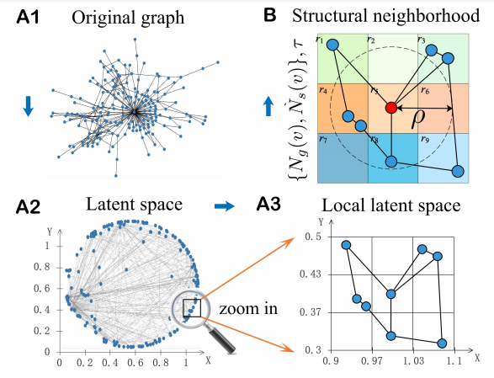
Node embedding
G = (V, E)
e ∈ E
v ∈ V
f : v → zv
zv ∈ R^{d}

Slide 11
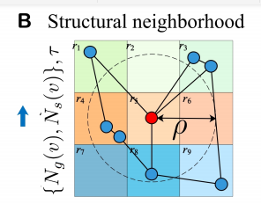
Structural Neighborhood
N (v) = ({Ng(v), Ns(v)}, τ )
{Ng(v), Ns(v)}, and a relational operator on nodes τ
The neighborhood in the graph:
Ng(v) = {u|u ∈ V,(u, v) ∈ E}
The neighborhood in the latent space: Ns(v) = {u|u ∈ V, d(zu, zv) < ρ}
τ : (zv, zu) → r ∈ R

Slide 12

R= {left upper, right upper, left lower, right lower}, and a τ (zv, zu)
Notice that, we adopt the rectangular coordinate system in the Euclidean space and angular coordinate in the hyperbolic space. By this way, the relationship “upper” indicates the node nearer to the origin and thus lie in a higher level in a hierarchical graph. One can design a more sophisticated operator τ , such as borrowing the structure of descriptors in manifold(high dimensional surface) geometry thereby preserving more and richer neighborhood structures.

Slide 13
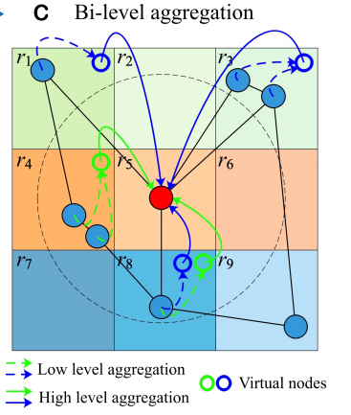
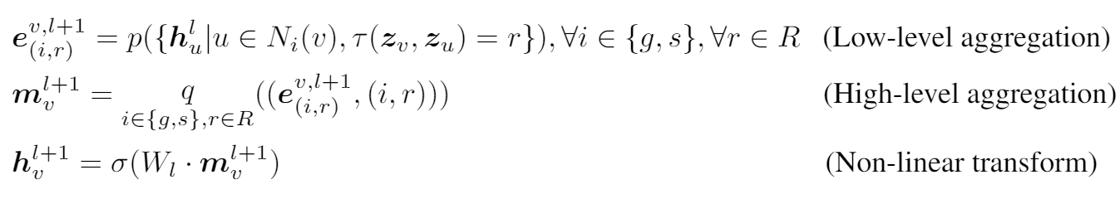
Bi-level Aggregation

Slide 14
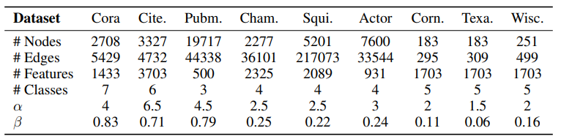
Experiments

Slide 15
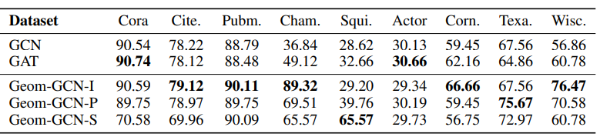
RESULTS AND ANALYSIS
Activation function: ReLU
Loss: Adam optimizer

Slide 16
Mean Classification Accuracy (Percent)
Dataset | Cora | Cite. | Pubm. | Cham. | Squi. | Actor | Corn. | Texa. | Wix.
GCN | 90.54 | 78.22 | 88.79 | 36.84 | 28.62 | 59.45 | 30.13 | 67.56 | 56.86
GAT | 90.74 | 78.12 | 88.48 | 49.12 | 32.66 | 30.66 | 62.16 | 64.86 | 60.78
Geom-GCN-I | 90.59 | 79.12 | 90.11 | 89.32 | 29.20 | 29.34 | 66.66 | 67.56 | 76.47
Geom-GCN-P | 89.75 | 78.97 | 89.75 | 69.51 | 39.76 | 30.19 | 59.45 | 75.67 | 70.58
Geom-GCN-S | 70.58 | 69.96 | 90.09 | 65.57 | 65.57 | 29.73 | 56.75 | 72.97 | 60.78

Slide 17
DATASET STATISTICS
Dataset | Cora | Cite. | Pubm. | Cham. | Squi. | Actor | Corn. | Texa. | Wix.
#NODES | 2708 | 3327 | 19717 | 2277 | 5201 | 7600 | 183 | 183 | 251
#EDGES | 5429 | 4732 | 44338 | 36101 | 217073 | 33544 | 295 | 309 | 499
#FEATURES | 1433 | 3703 | 500 | 2325 | 2089 | 931 | 1703 | 1703 | 1703
#CLASSES | 7 | 6 | 3 | 5 | 5 | 5 | 5 | 5 | 5

Slide 18
Related Work
Hongyun Cai, Vincent W Zheng, and Kevin Chen-Chuan Chang. A comprehensive survey of graph
embedding: Problems, techniques, and applications. IEEE Transactions on Knowledge and Data
Engineering, 30(9):1616–1637, 2018.

Slide 19
Hongyun Cai, Vincent W Zheng, and Kevin Chen-Chuan Chang. A comprehensive survey of graph
embedding: Problems, techniques, and applications.

